Slide 1
Designing ML Week 8:
A survey of AI Ethics
michelle.carney@berkeley.edu

Slide 2



Notes:
https://ctsp.berkeley.edu/
http://afog.berkeley.edu/

Slide 3
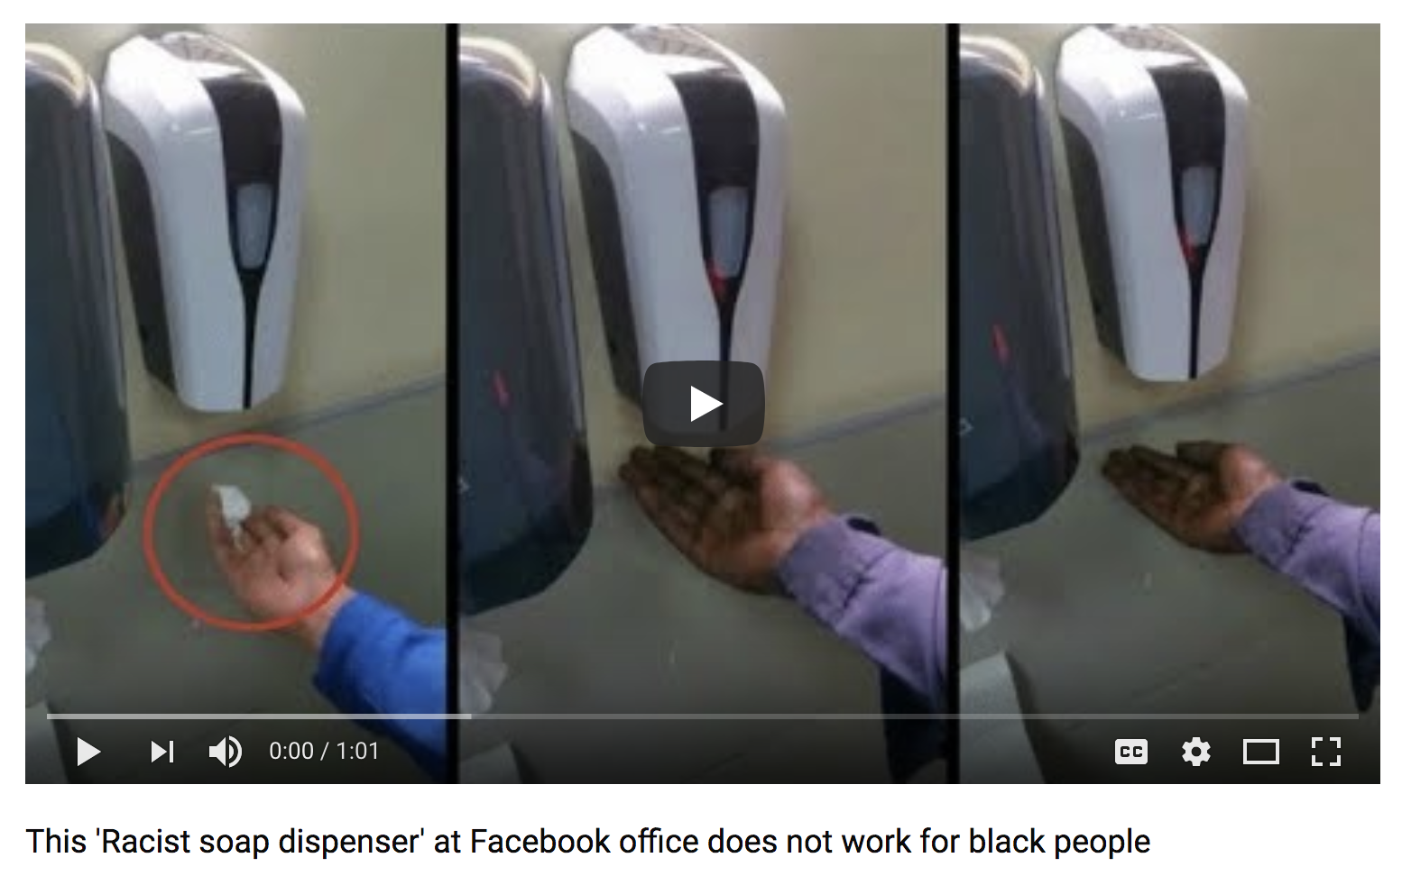
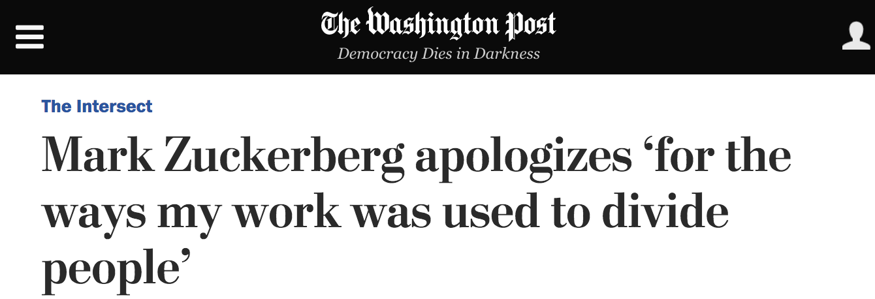
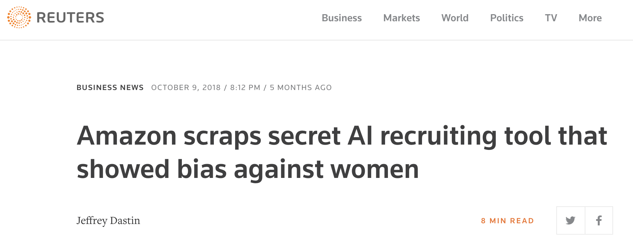
Notes:
https://www.reuters.com/article/us-amazon-com-jobs-automation-insight/amazon-scraps-secret-ai-recruiting-tool-that-showed-bias-against-women-idUSKCN1MK08G
https://www.washingtonpost.com/news/the-intersect/wp/2017/10/01/mark-zuckerberg-apologizes-for-the-ways-my-work-was-used-to-divide-people/?noredirect=on&utm_term=.3650d7bd683a
https://www.youtube.com/watch?v=YJjv_OeiHmo

Slide 4
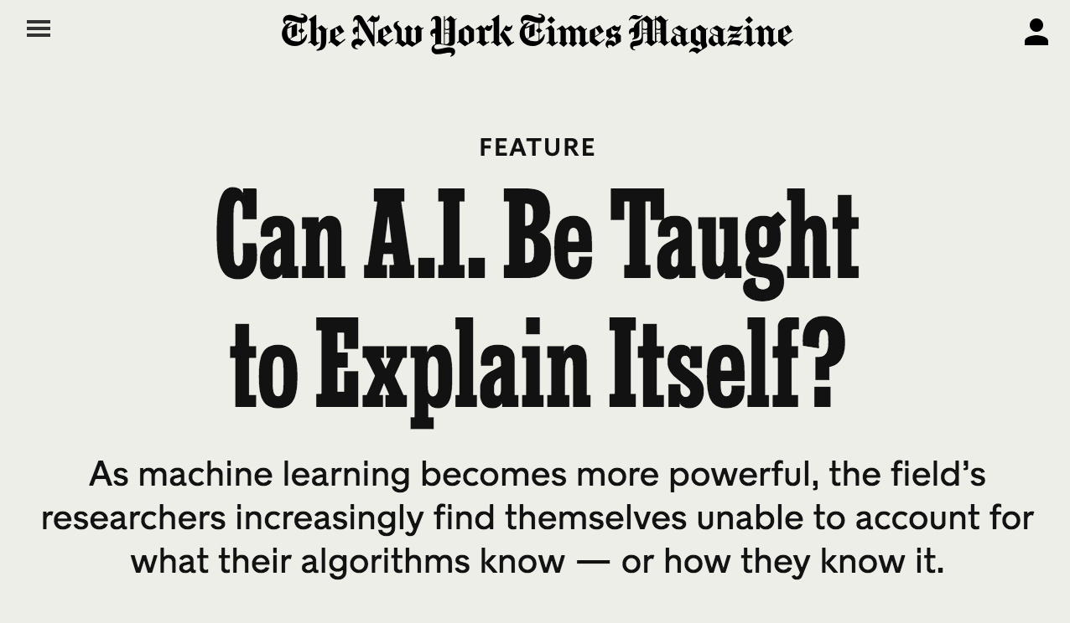
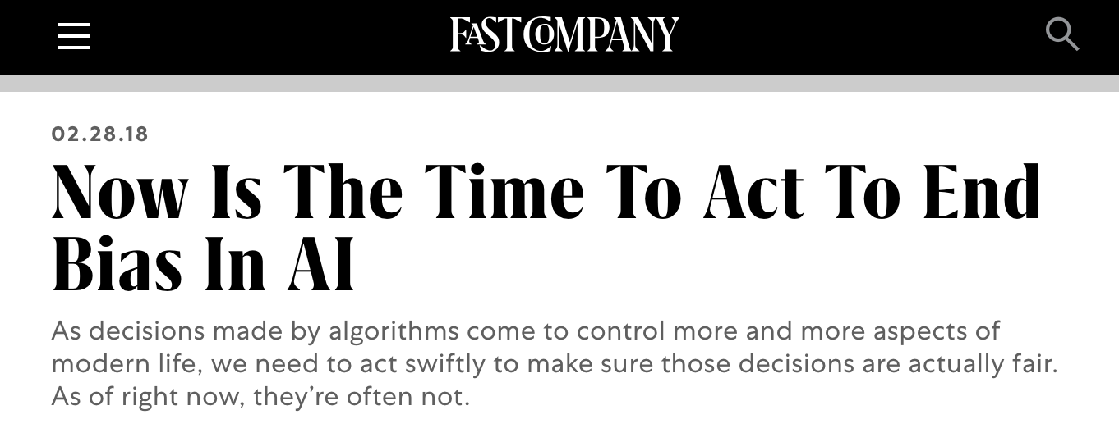
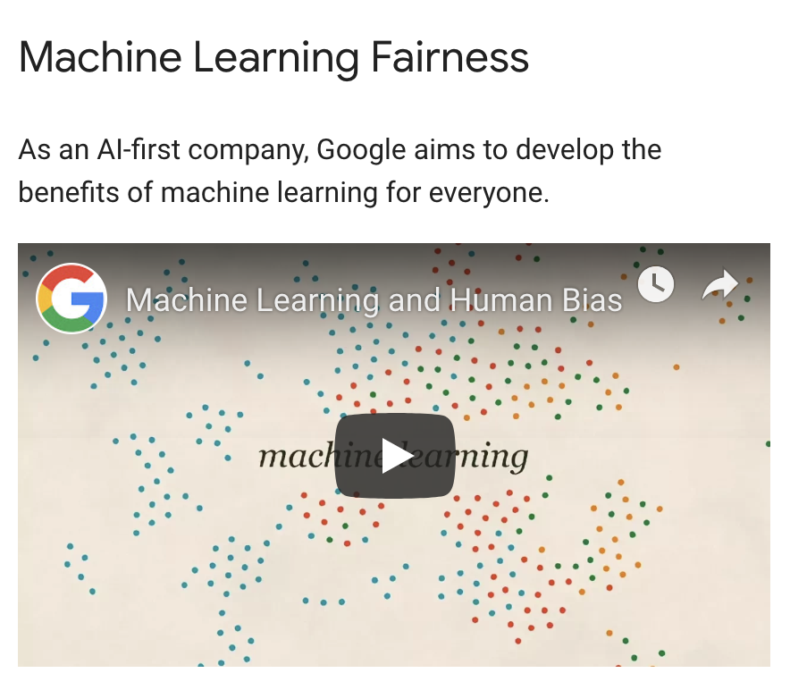
Notes:
https://www.nytimes.com/2017/11/21/magazine/can-ai-be-taught-to-explain-itself.html
https://www.fastcompany.com/40536485/now-is-the-time-to-act-to-stop-bias-in-ai
https://developers.google.com/machine-learning/fairness-overview/

Slide 5
What do these terms mean to you?
Fairness
Transparency
Bias
Explainability
Interpretability

Slide 6
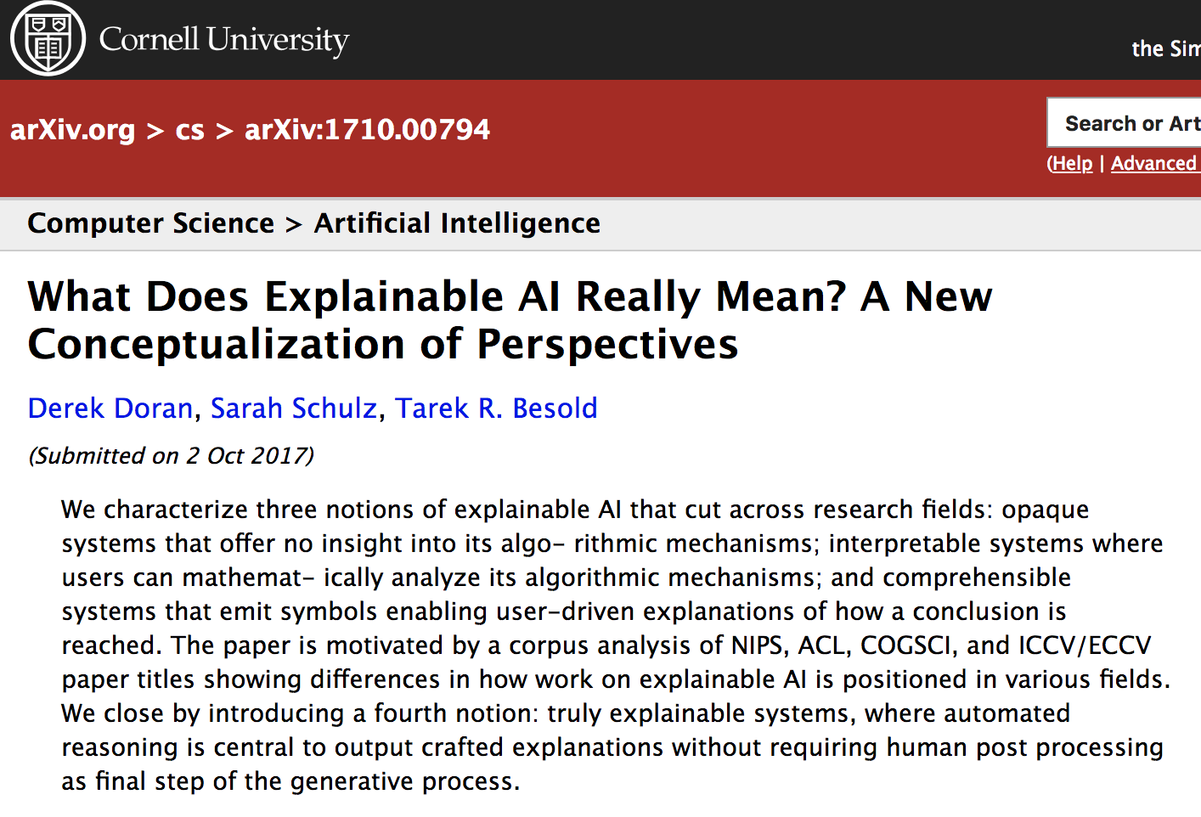
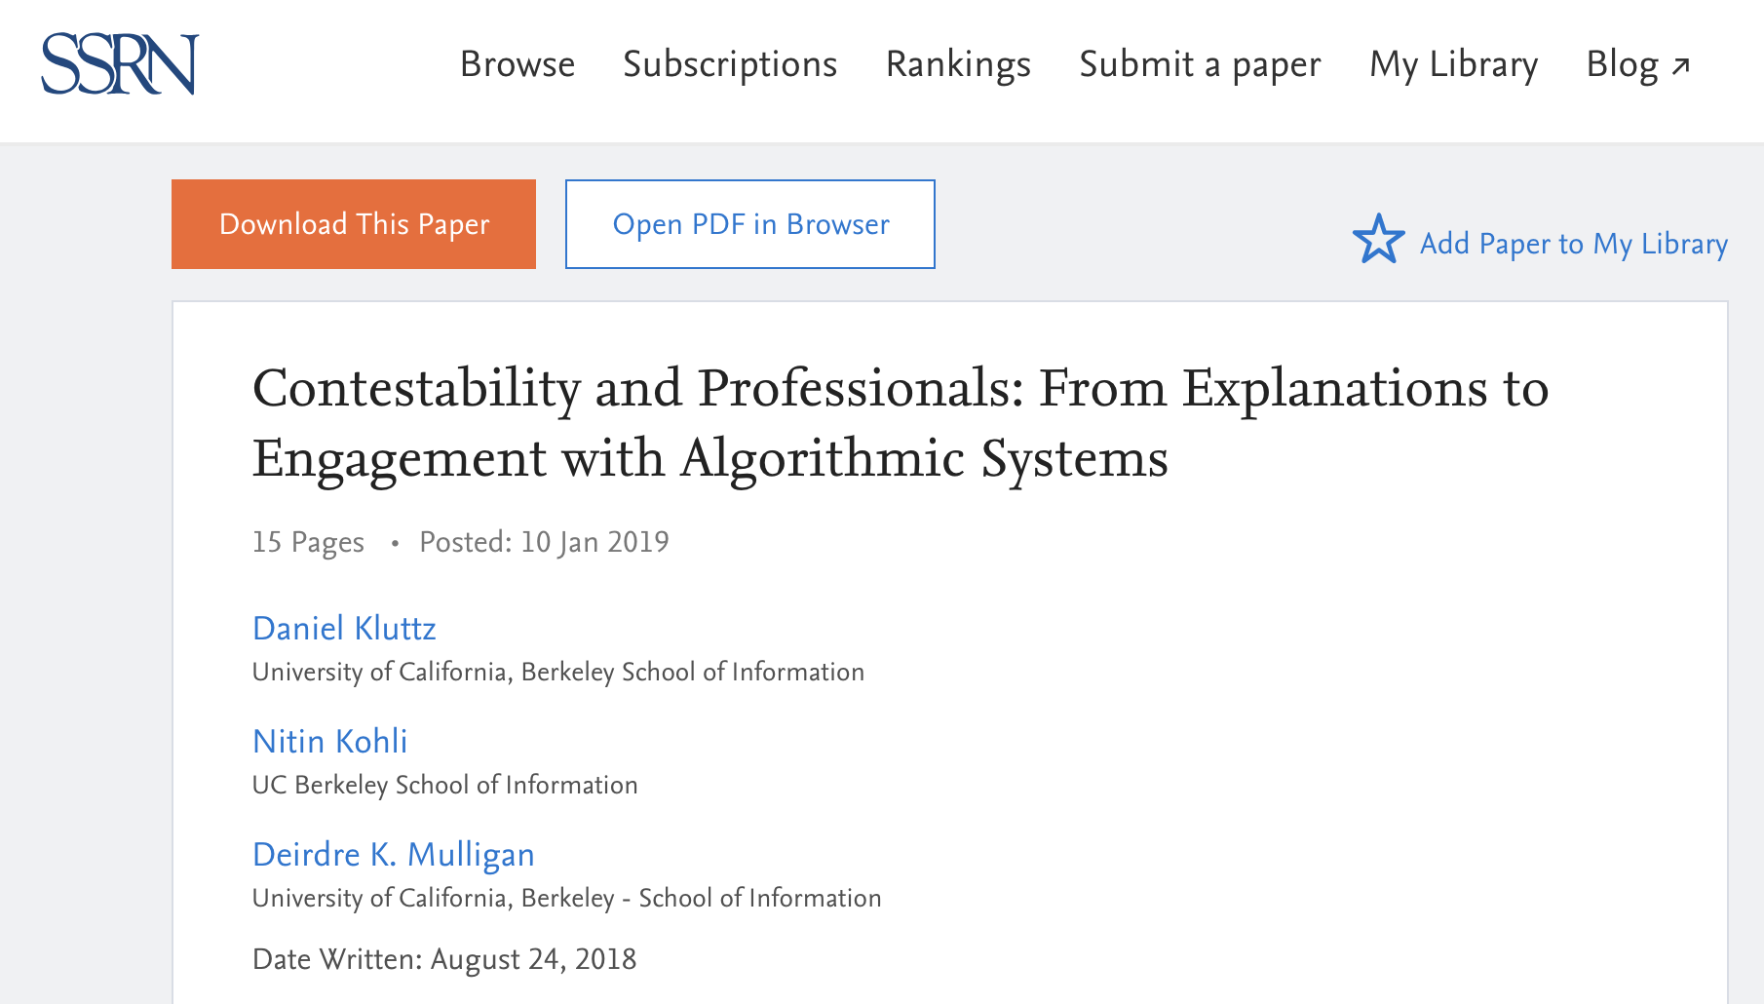
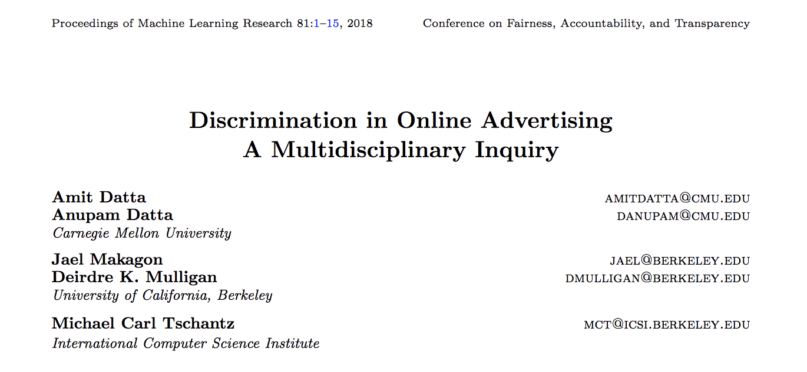
Notes:
https://arxiv.org/abs/1710.00794
https://papers.ssrn.com/sol3/papers.cfm?abstract_id=3311894
https://escholarship.org/uc/item/4rw2z9f8

Slide 7
Data design
Model design
Output design
Data
Model Interaction
Model
Evaluating
Data Cleaning
Model Output
Model Building

Slide 8
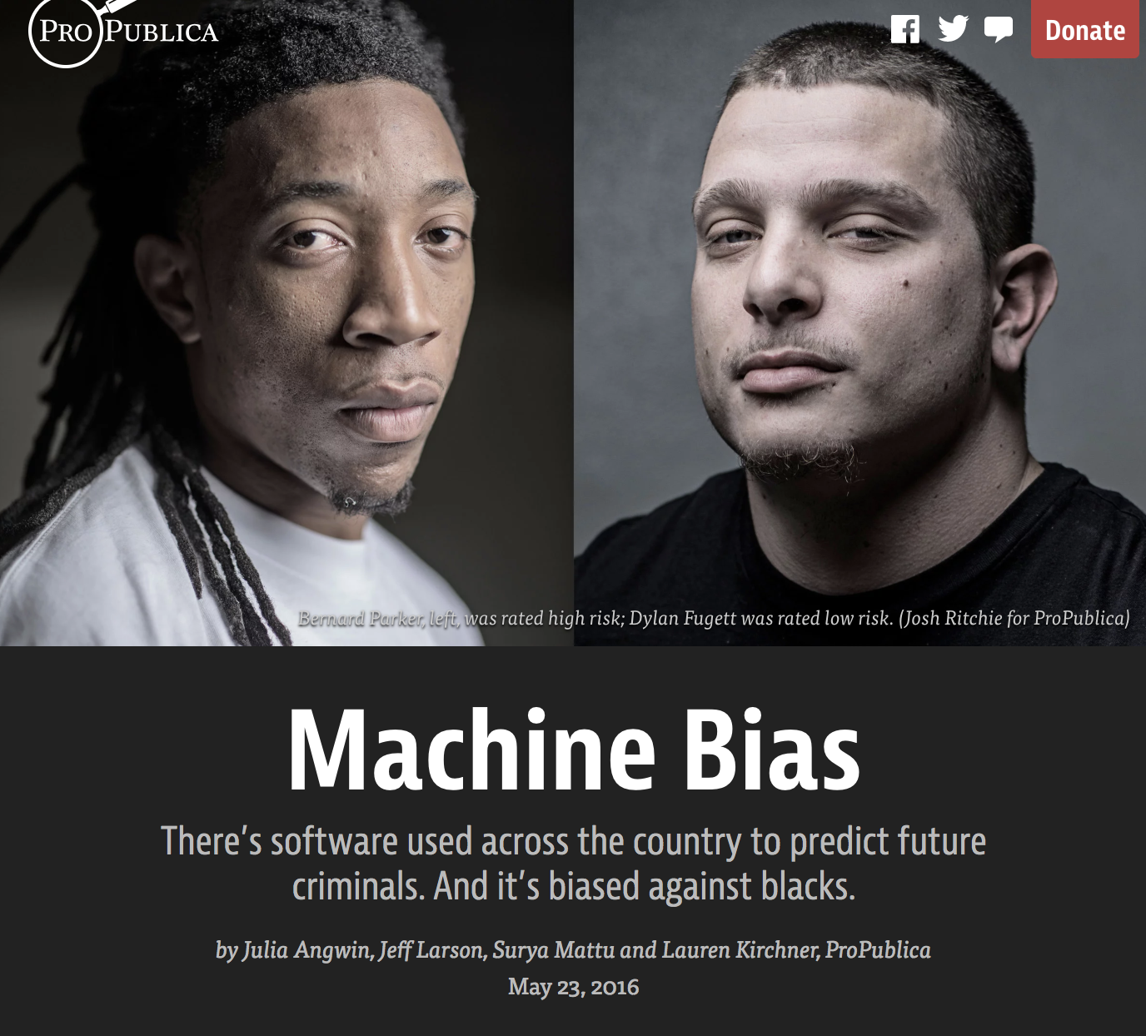
Notes:
https://www.propublica.org/article/machine-bias-risk-assessments-in-criminal-sentencing

Slide 9
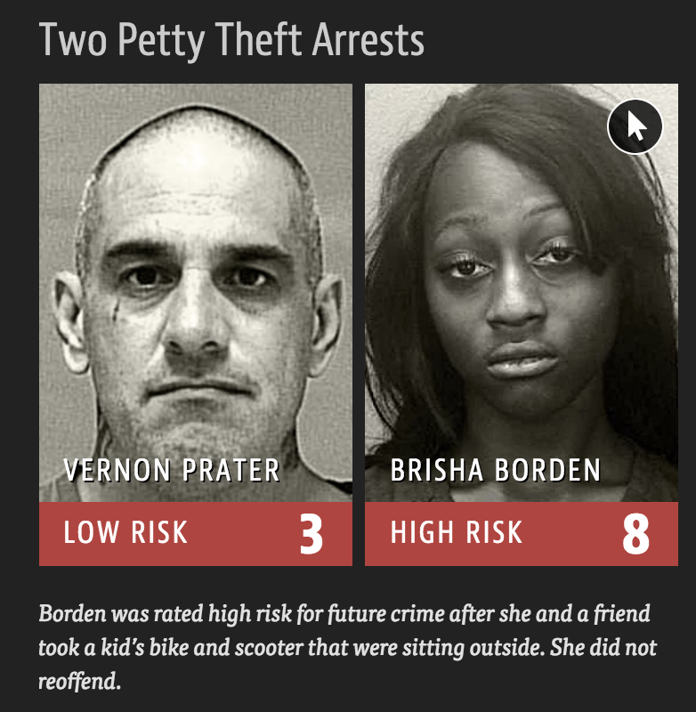
Notes:
https://www.propublica.org/article/machine-bias-risk-assessments-in-criminal-sentencing

Slide 10
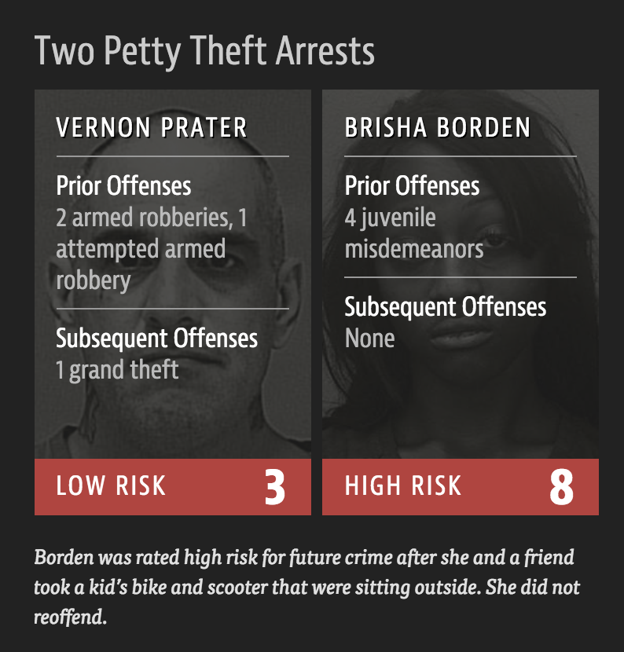
Notes:
https://www.propublica.org/article/machine-bias-risk-assessments-in-criminal-sentencing

Slide 11
Data design
Model design
Output design
Data
Model Interaction
Model
Evaluating
Data Cleaning
Model Output
Model Building

Slide 12
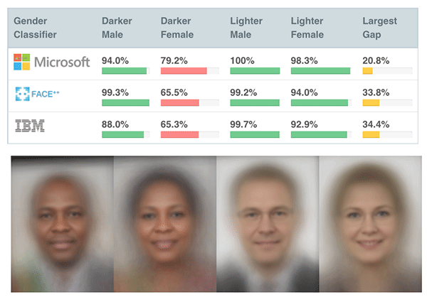
Buolamwini and Gebru (2018)

Slide 13
Data design
Model design
Output design
Data
Model Interaction
Model
Evaluating
Data Cleaning
Model Output
Model Building

Slide 14
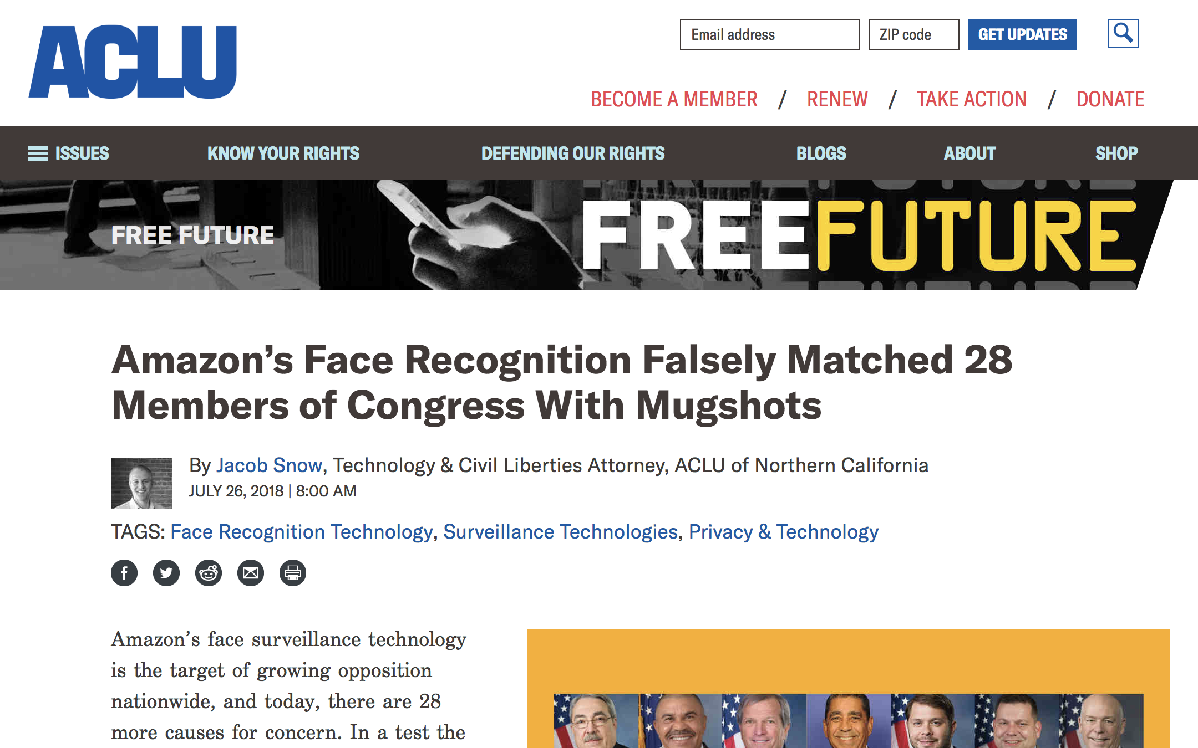
Notes:
https://www.aclu.org/blog/privacy-technology/surveillance-technologies/amazons-face-recognition-falsely-matched-28

Slide 15
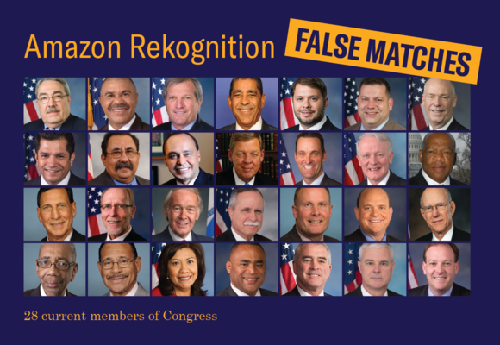
“Our test used Amazon Rekognition to compare images of members of Congress with a database of mugshots. The results included 28 incorrect matches. “
Notes:
https://www.aclu.org/blog/privacy-technology/surveillance-technologies/amazons-face-recognition-falsely-matched-28

Slide 16
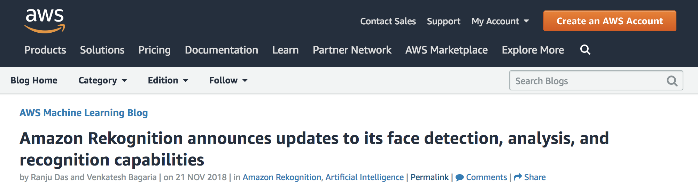
Notes:
https://aws.amazon.com/blogs/machine-learning/amazon-rekognition-announces-updates-to-its-face-detection-analysis-and-recognition-capabilities/

Slide 17




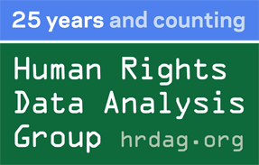
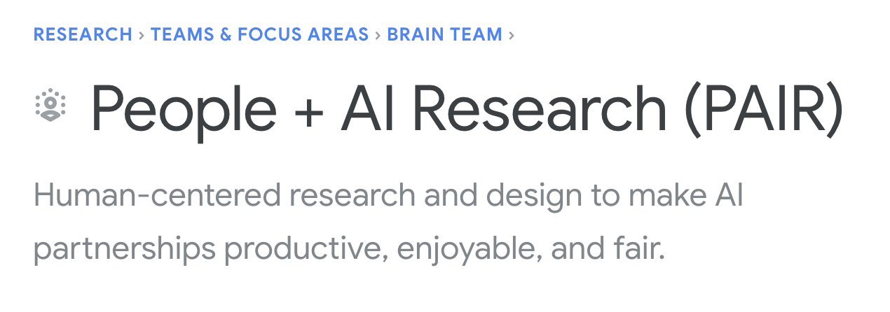
Interested in learning more...?
Notes:
https://ainowinstitute.org/
https://www.partnershiponai.org/
https://datasociety.net/
https://humancompatible.ai/
https://ai.google/research/teams/brain/pair
https://fatconference.org/2019/acceptedpapers.html
https://hrdag.org/

Slide 18
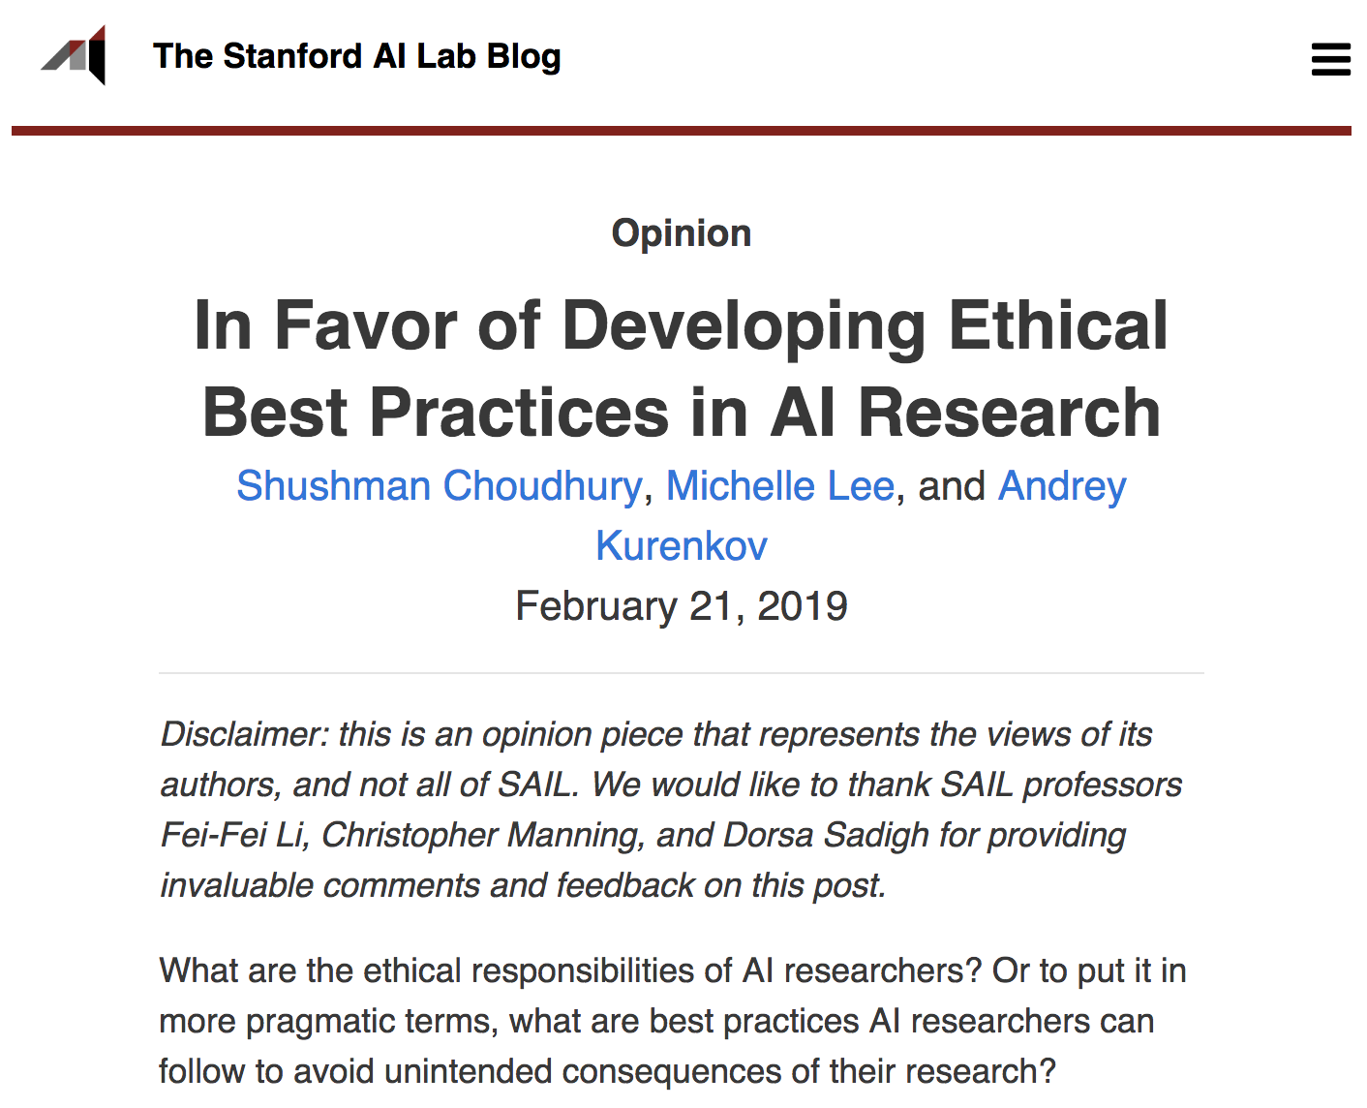
Notes:
http://ai.stanford.edu/blog/ethical_best_practices/

Slide 19
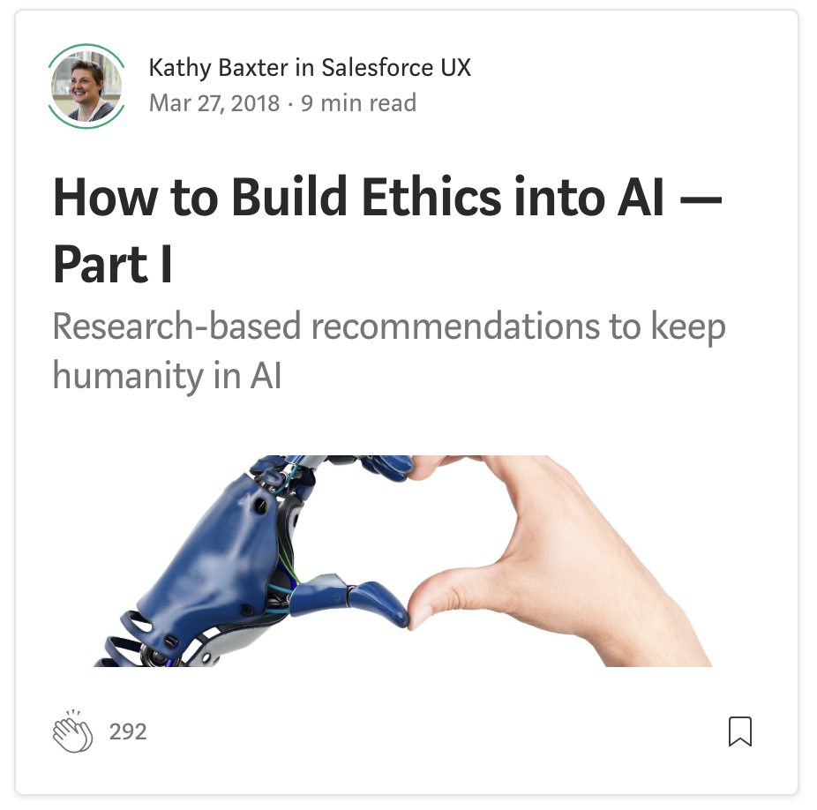
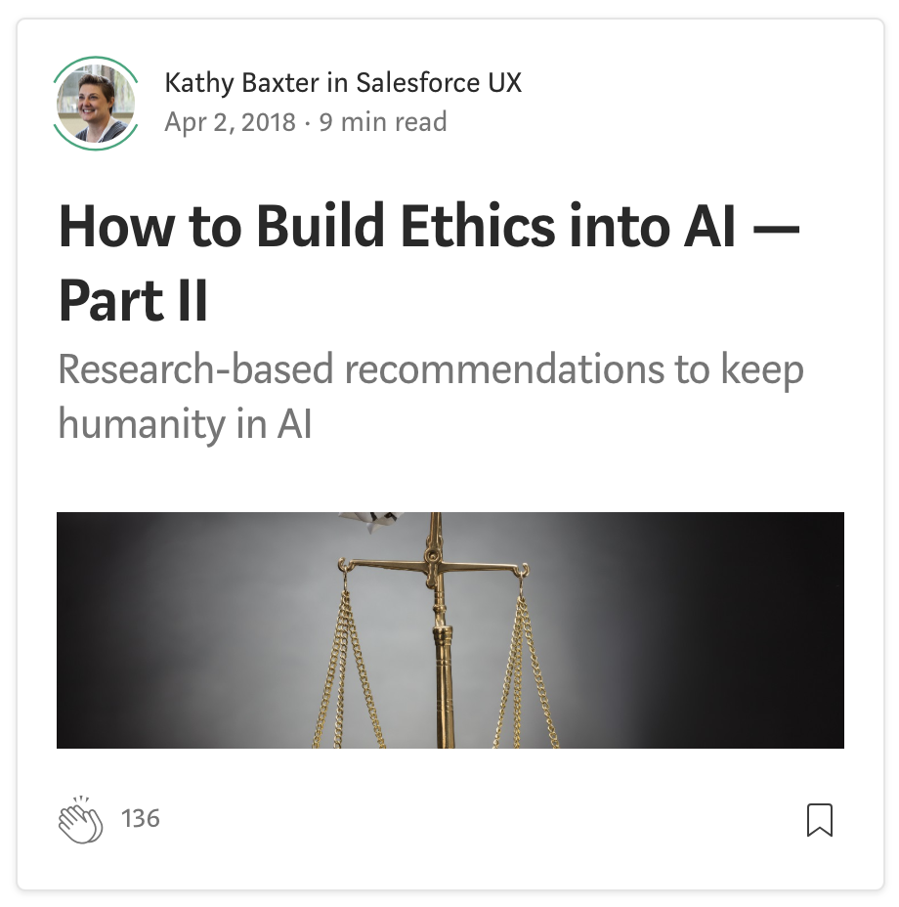
Notes:
https://medium.com/@kathykbaxter

Slide 20
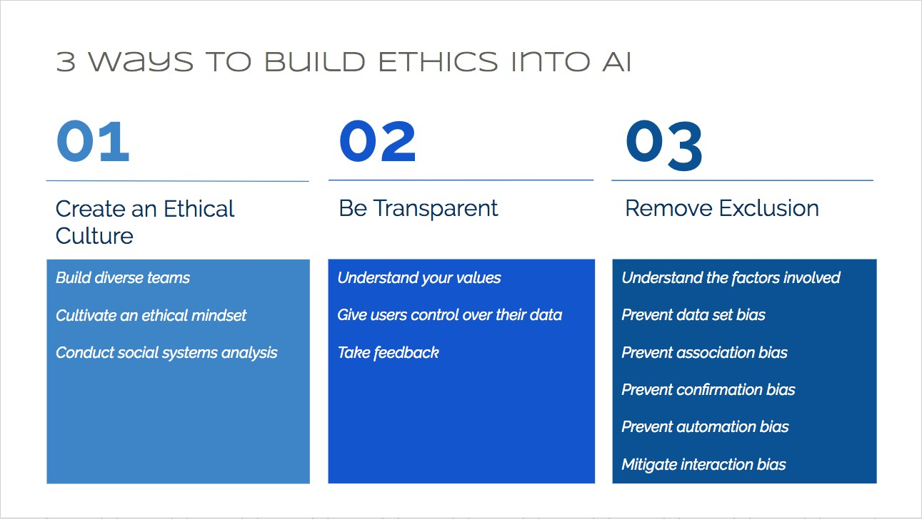
From Kathy Baxter (AI Ethics Architect @ Salesforce)...

Slide 21
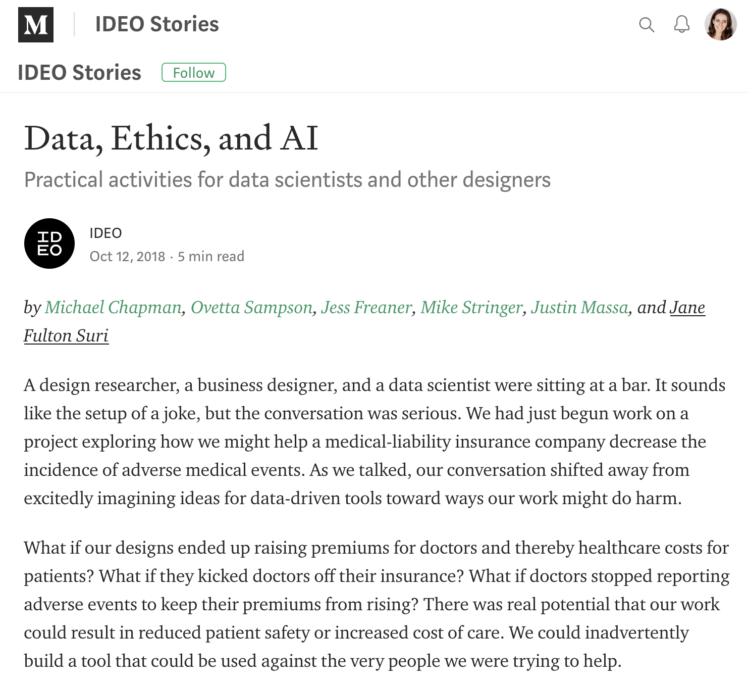

Slide 22
From Data, Ethics, and AI - IDEO
1. Data is not truth
2. Just because AI can do something doesn’t mean it should
3. Respect privacy and the collective good
4. Unintended consequences of AI are opportunities for design

Slide 23

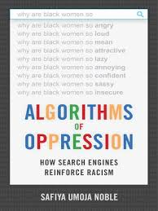
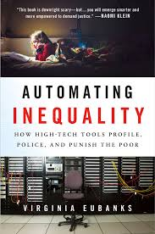
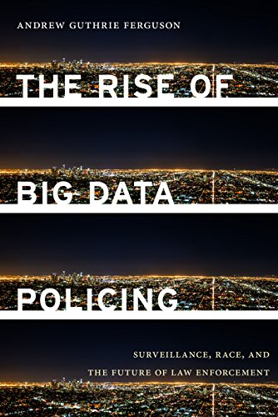
Recommended reading

Slide 24
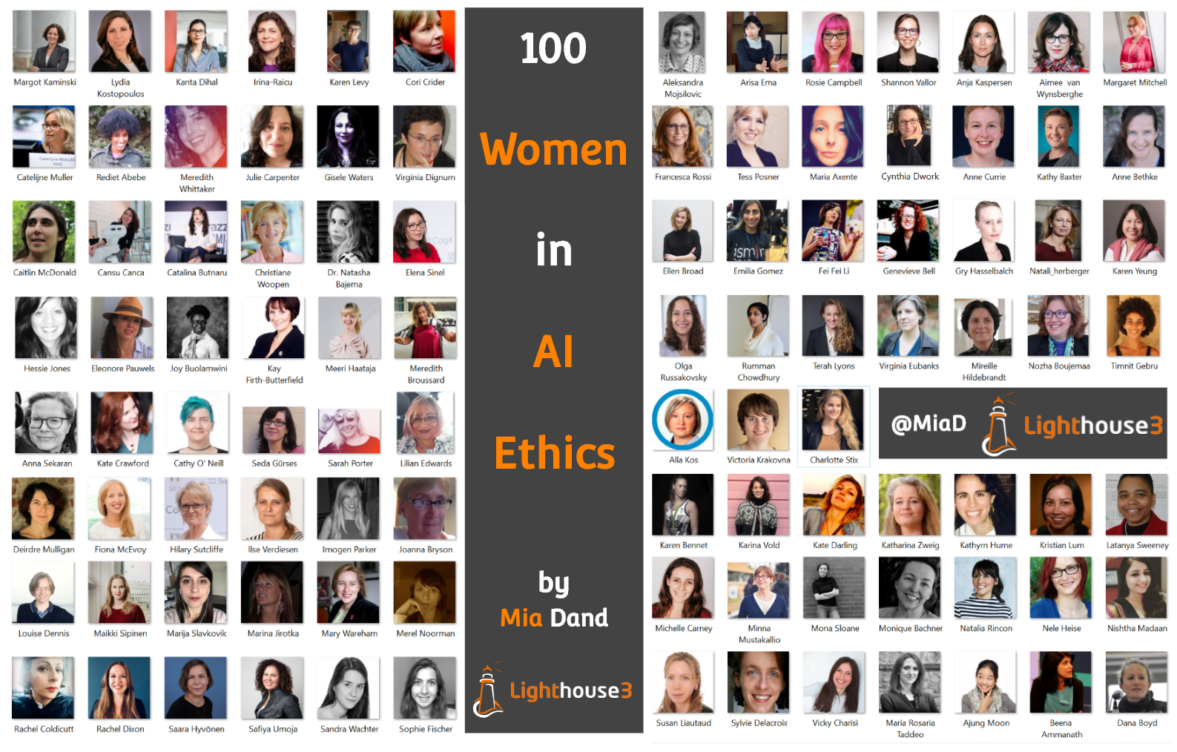
Notes:
https://becominghuman.ai/100-brilliant-women-in-ai-ethics-to-follow-in-2019-and-beyond-92f467aa6232

Slide 25
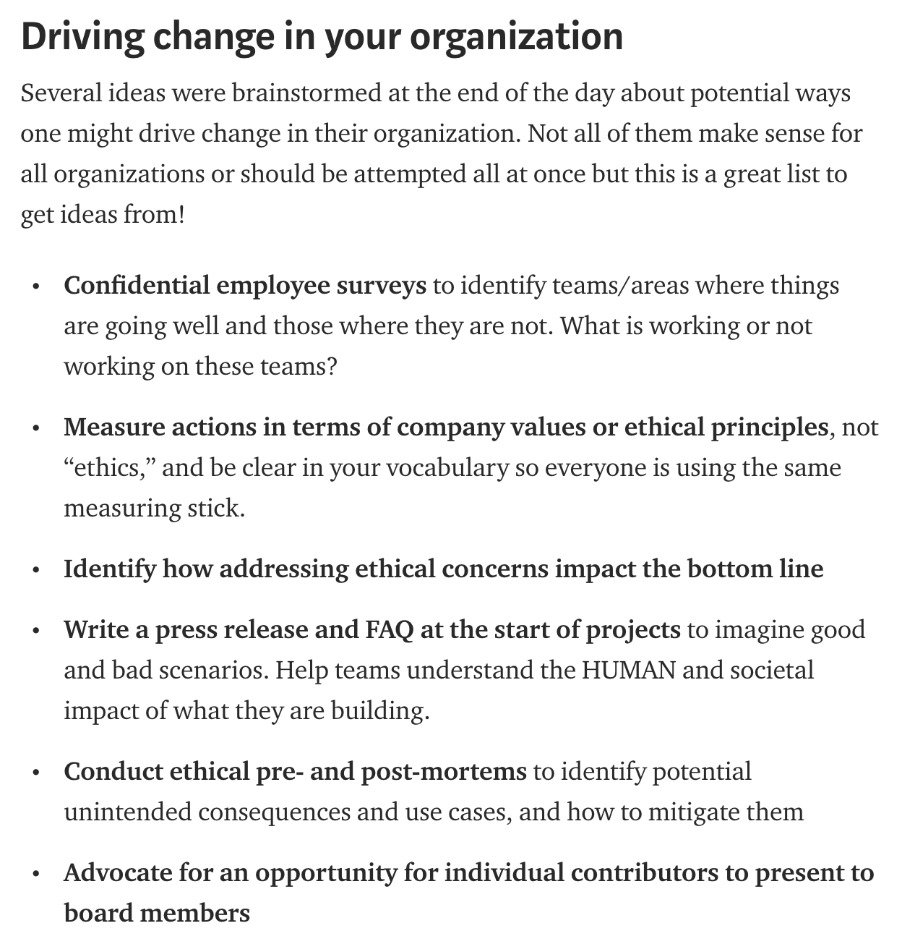
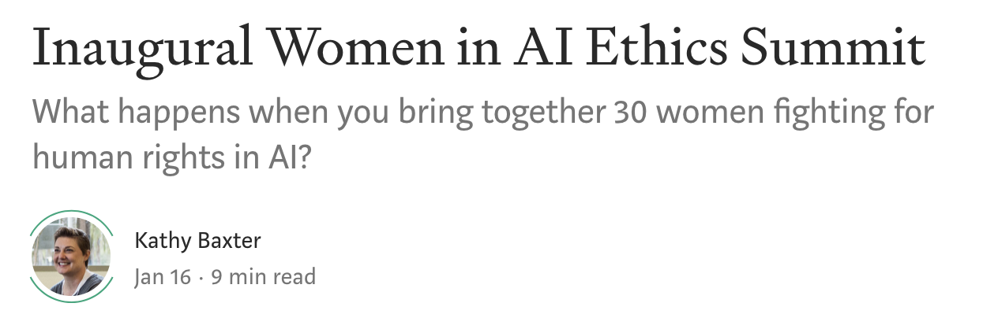
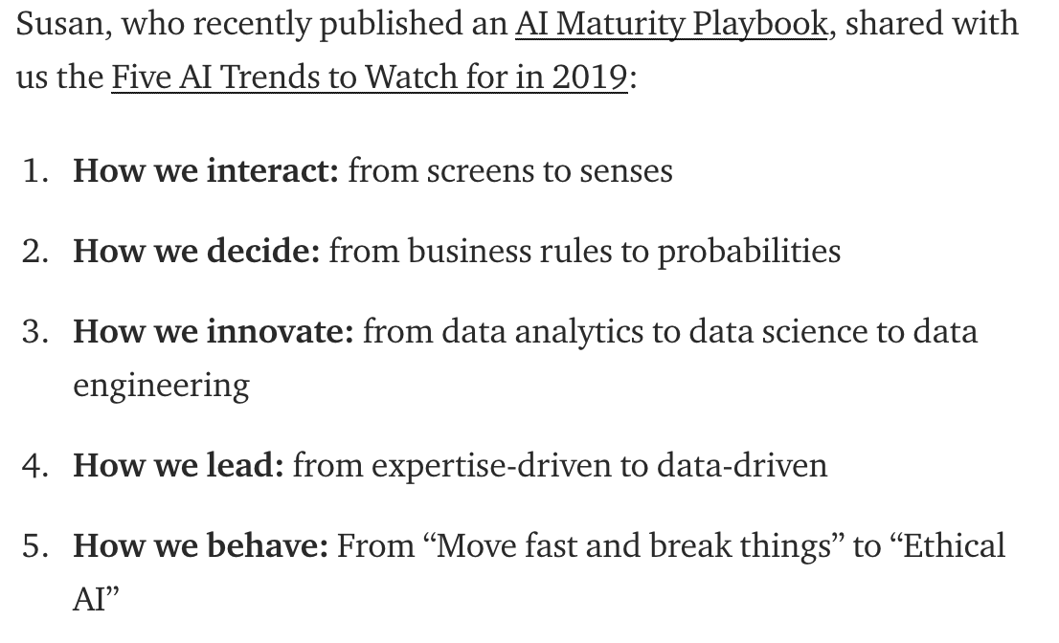
Notes:
https://medium.com/datadriveninvestor/inaugural-women-in-ai-ethics-summit-5440bd59da45

Slide 26
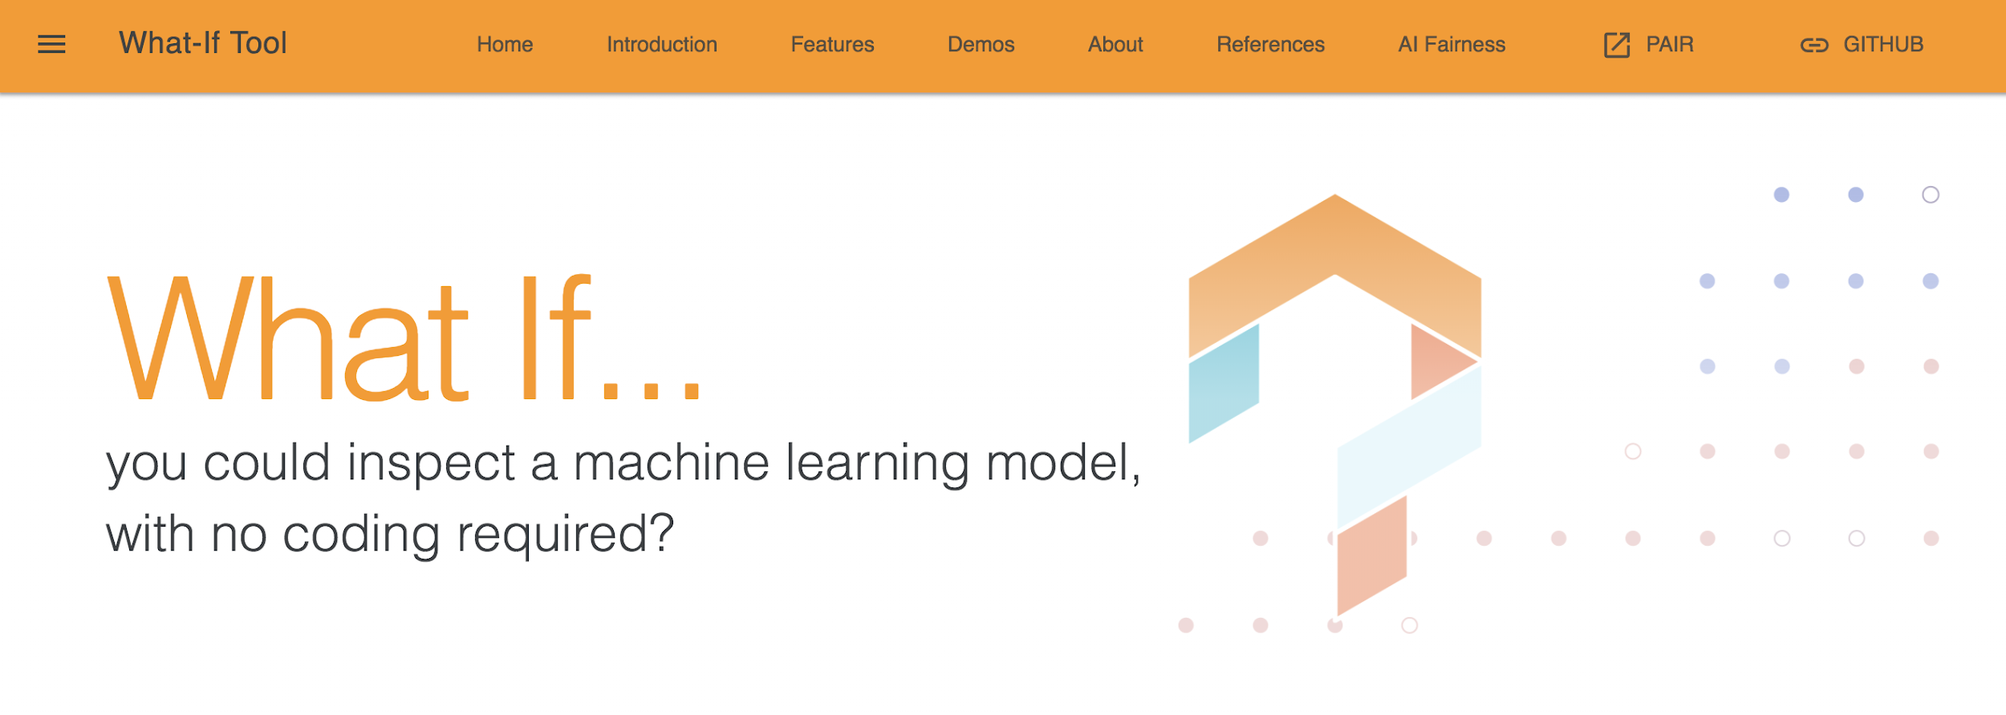
Notes:
https://pair-code.github.io/what-if-tool/index.html

